Slide 1
A machine learning approach for predicting heart disease and diabetes
SympTrack

Slide 2

Mini Project Final Review Presented by
ROLL NUMBER | NAME OF THE STUDENT
21AG1A6754 | P. BHAVYA
21AG1A6738 | L. ABHIRAM
21AG1A6761 | B. THARUN GOUD
21AG1A6762 | T. SRIVATHSA
Under the supervision of
Mr. M. Hari Krishna, Assistant Professor
DEPARTMENT OF CSE (DATA SCIENCE)
ACE Engineering College

Slide 3
Content
Introduction
Existing System
Proposed Model
Software Requirement Specifications
Hardware Requirement Specifications
Functional & Non-Functional Requirements
System Analysis
Pipeline Architecture
System Design
Implementation
Conclusion
References

Slide 4
Introduction
Heart disease is a leading cause of death globally, affecting various conditions like coronary artery disease.
Diabetes is a chronic illness that disrupts glucose processing, leading to serious complications.
Predicting these conditions early helps with timely treatment and lowers healthcare costs. Machine learning improves accuracy by analyzing data and automating predictions, making healthcare more efficient.

Slide 5
Existing System
Logistic regression predicts heart disease by estimating the probability of disease based on factors like age, cholesterol, and blood pressure. It provides a binary output: disease (1) or no disease (0).
Support Vector Machine (SVM) predicts diabetes by creating a boundary that separates diabetic and non-diabetic patients based on features like glucose and age. It can work well even when the data is not linearly separable.

Slide 6
Proposed Model
Combined Risk Model: Predict the likelihood of a patient having both heart disease and diabetes.
Understanding Risk Factors: Shared risk factors like cholesterol levels and family history increase the chances of heart disease and diabetes.
Patient Classification: Help doctors quickly identify high-risk patients for early treatment and prevention.

Slide 7
Software Requirement Specifications
Operating System: Linux/Windows 10 or above
Programming Languages: Python
IDE: Visual Studio Code
Libraries used: Streamlit, NumPy, Pandas, sklearn
Hardware Requirement Specifications
Processor: AMD Ryzen™ 3 / Intel Core i3 or above
Memory : 8GB
Hard Disk : 256GB SSD

Slide 8
Functional & Non-Functional Requirements
Functional Requirements
User Data Input
Data Validation
Risk Prediction Model
Results Display
Report Generation
Non-Functional Requirements
Scalability
Usability
Reliability
Performance

Slide 9
System Analysis
Interaction Module: Interface for a health care professional to predict and view prediction results.
Key Components: Input entry, User Interface (Streamlit), View results
Model Saving Module:
Saving the trained model using pickle library.
Key Components: Import pickle and use pickle.dump() to serialize and save the trained model to a file.
Use pickle.load() to deserialize and load the model for reuse.
Prediction Module:
Analyze input data to predict diabetes and heart disease.
Key Components: Data Collection, ML model (Random Forest), Predict(Diabetes and Heart disease result)

Slide 10
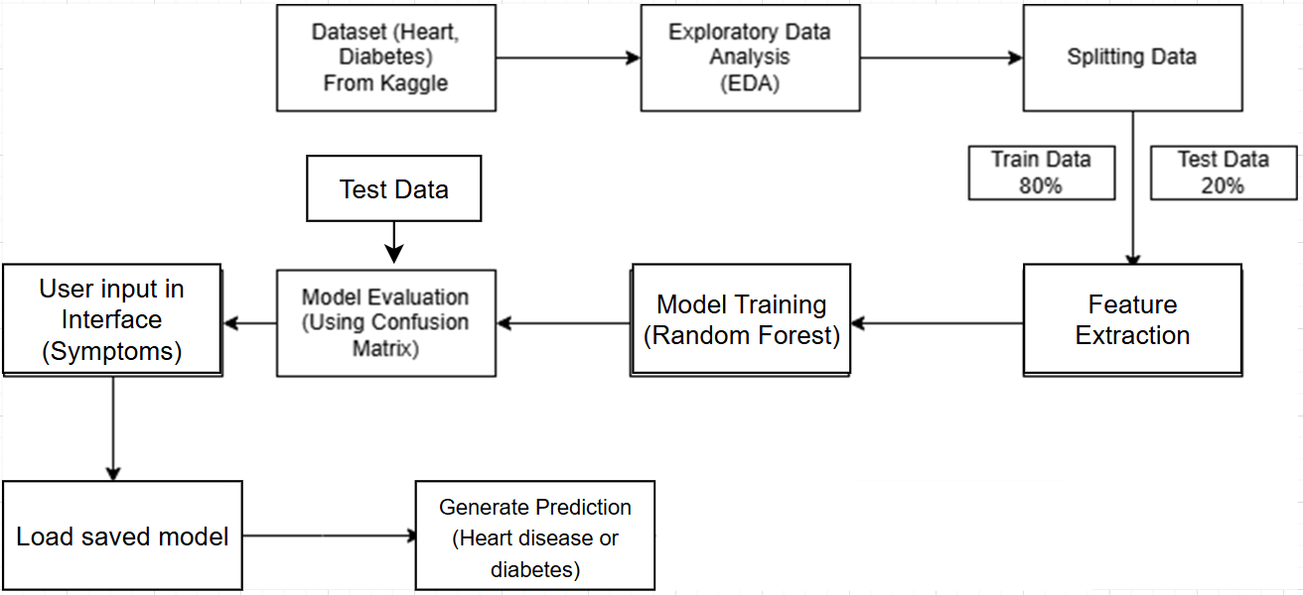





Pipeline Architecture
Notes:
Dataset names(heart,diabetes), model testing, evaluation(confusion matrix), accuracy, remove data preprocessing

Slide 11
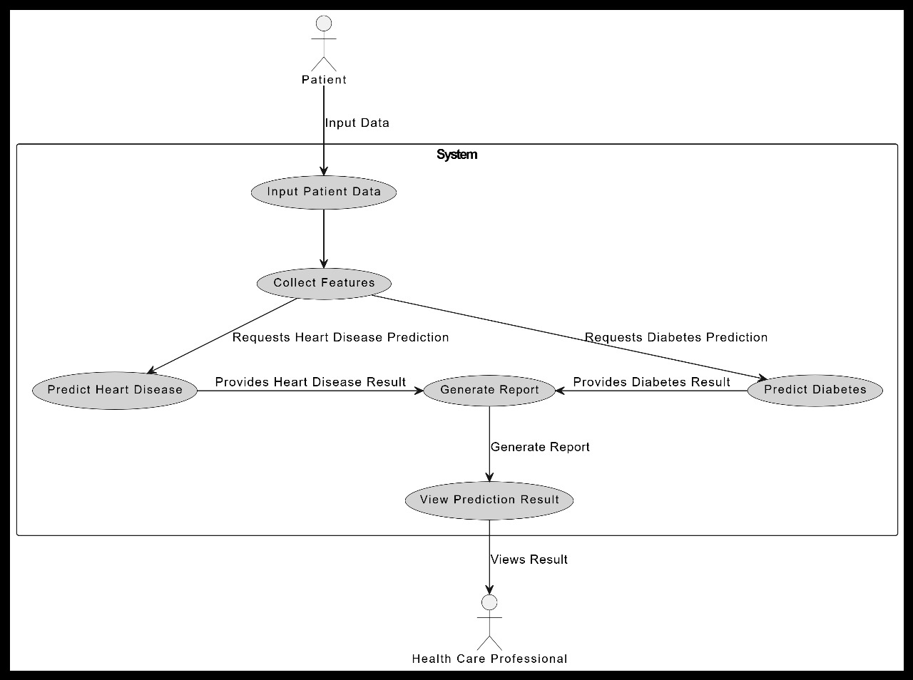






Use Case Diagram
Views Result
Health Care Professional
Notes:
Put actor outside the system

Slide 12
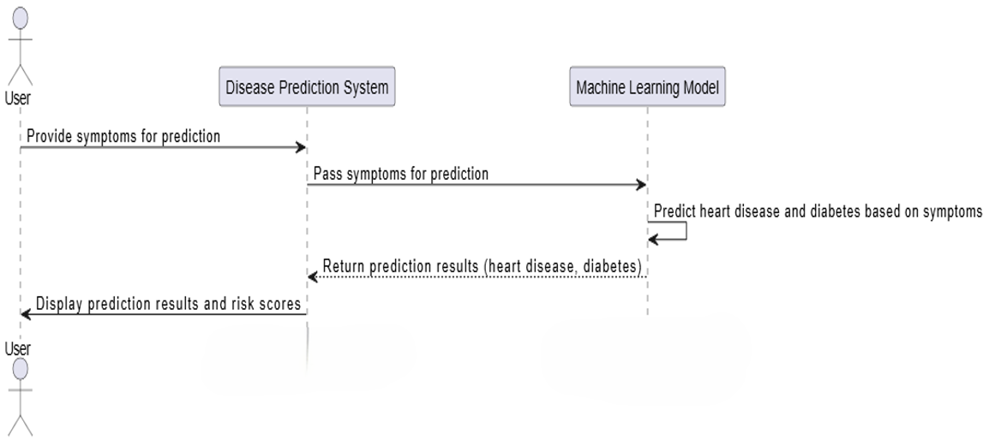

Sequence Diagram
and generate report
Health Care Professional
Notes:
Report generation, arrows between actors

Slide 13
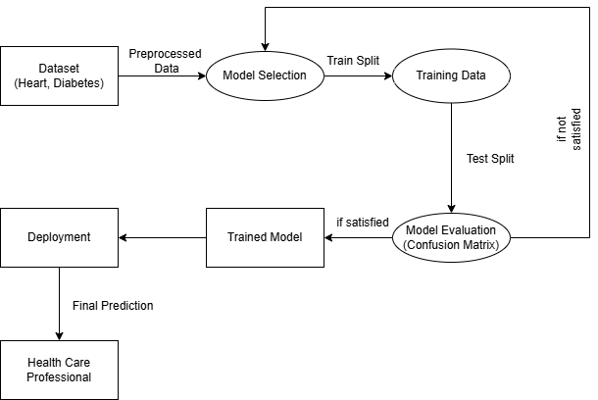
Data Flow Diagram
Notes:
Change diagram

Slide 14
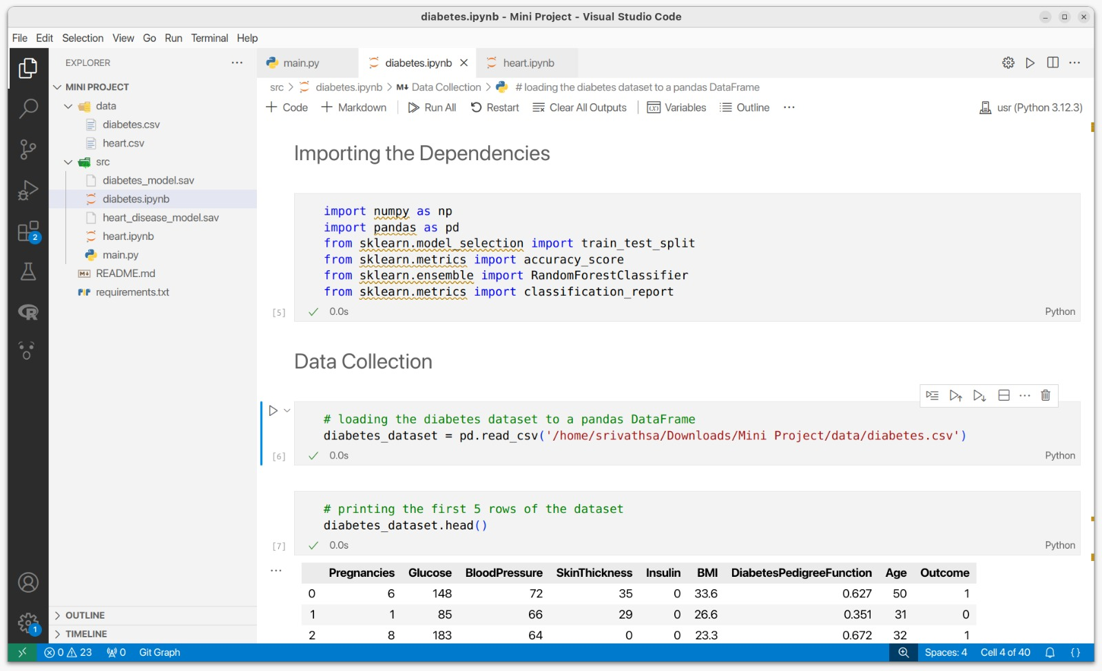
Importing necessary libraries

Slide 15
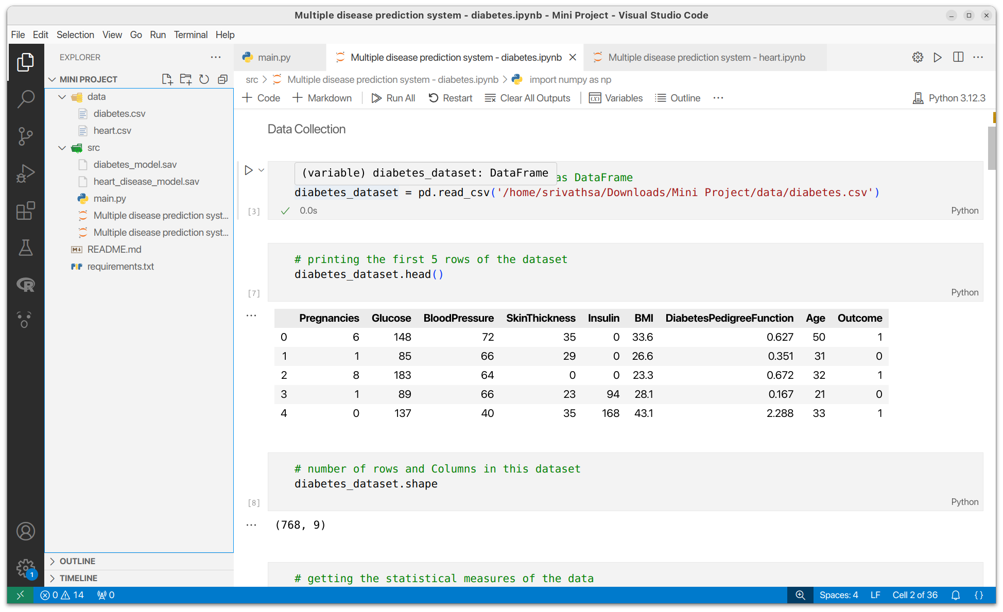
Loading the Dataset

Slide 16
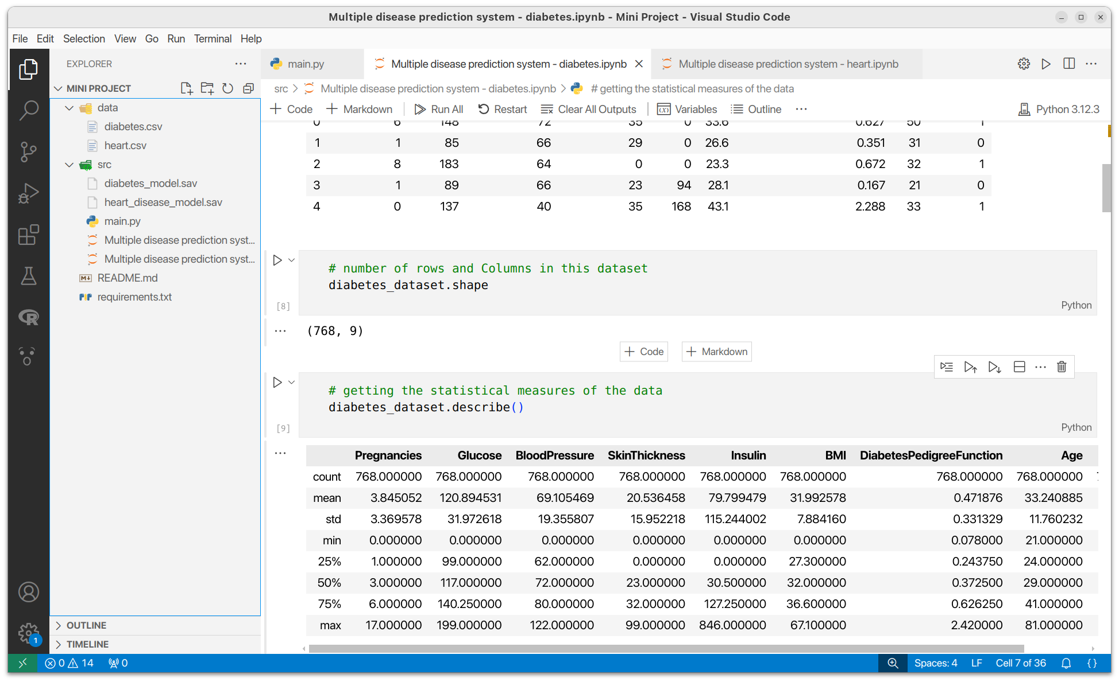
Data Description

Slide 17
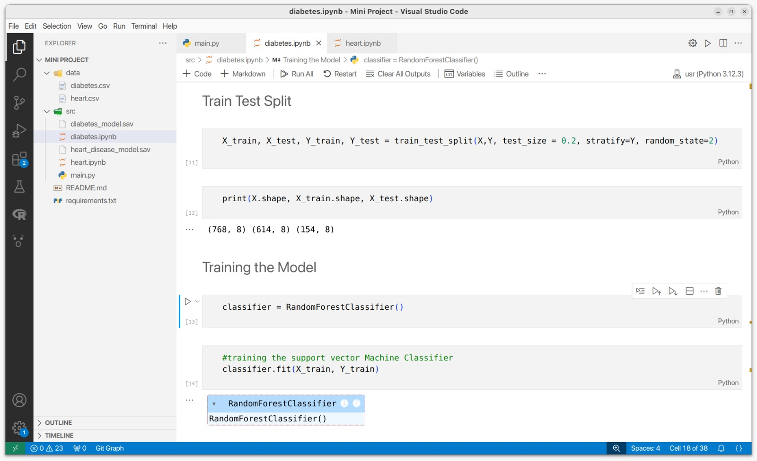
Train Test Split

Slide 18
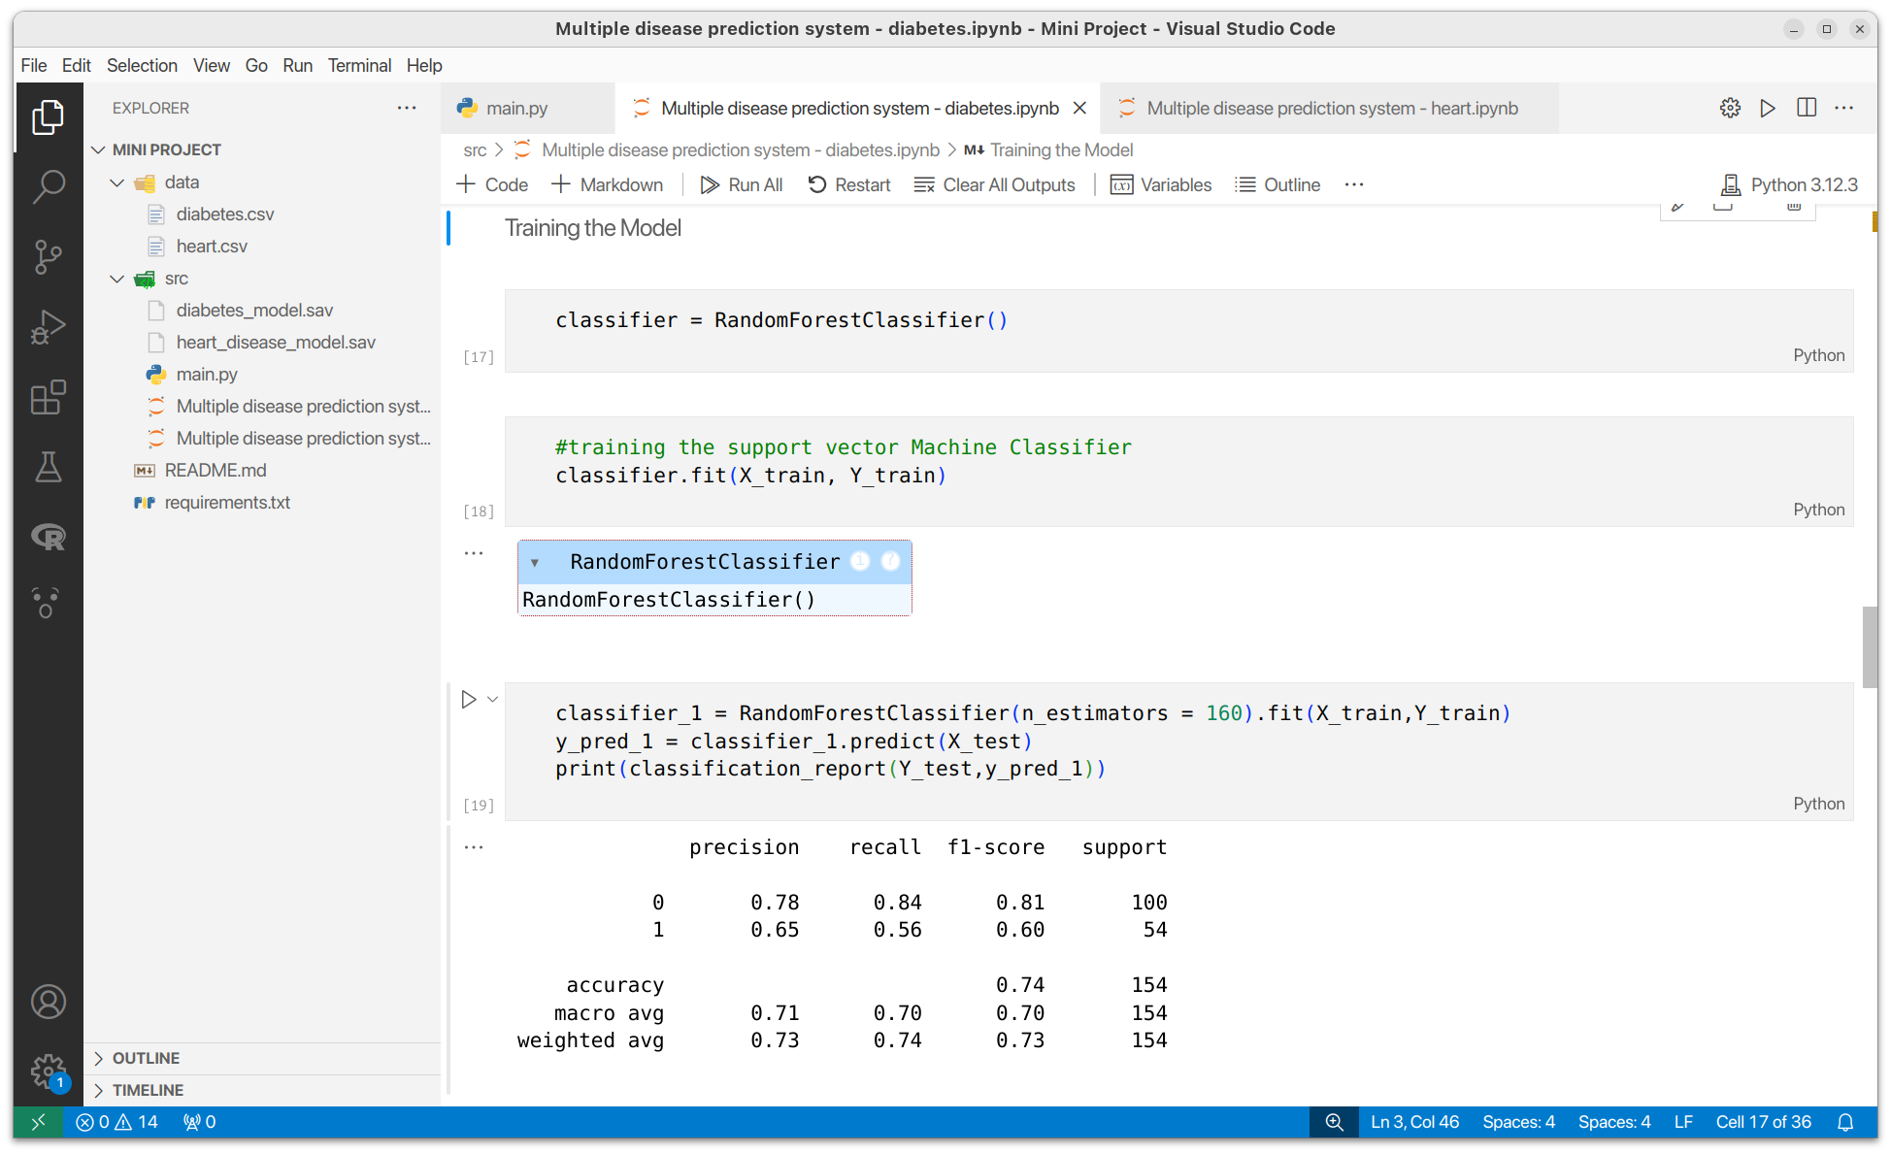
Training the model
Notes:
Train test split

Slide 19
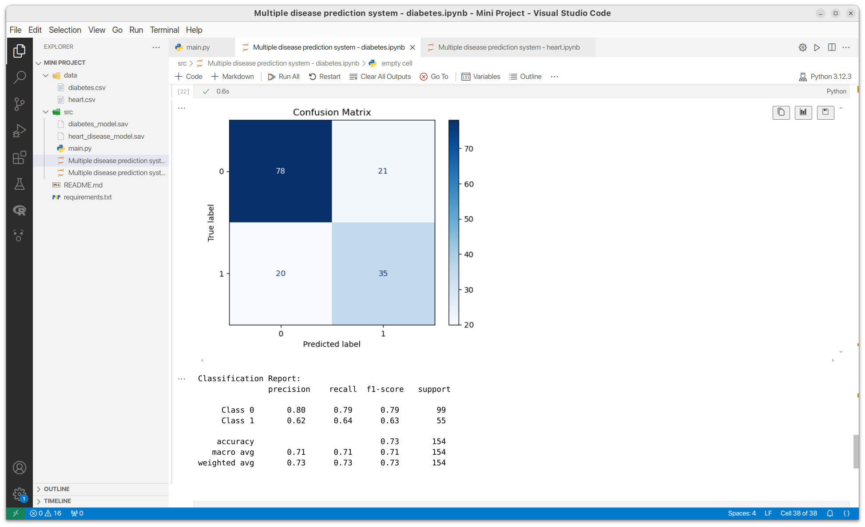
Evaluation of model
(using random forest)

Slide 20
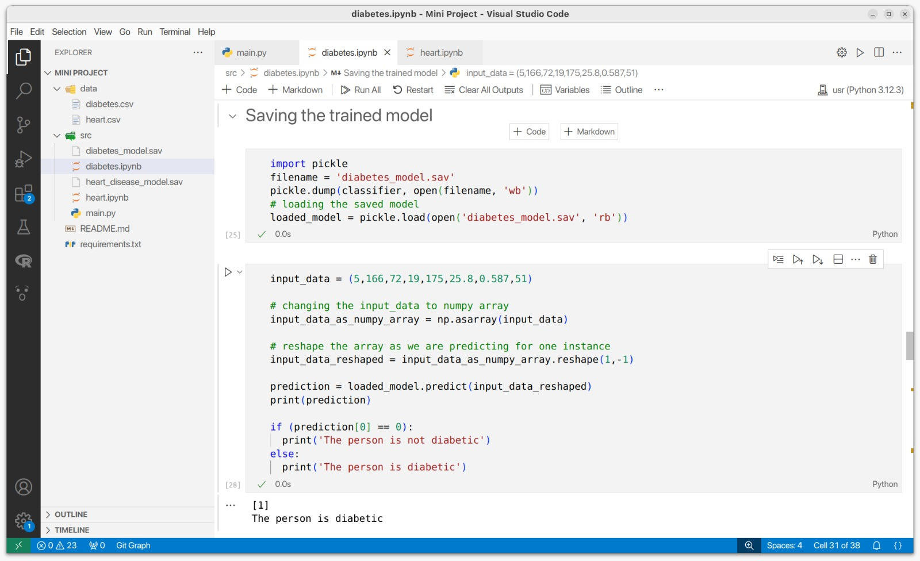
Saving the trained model (using pickle library)

Slide 21
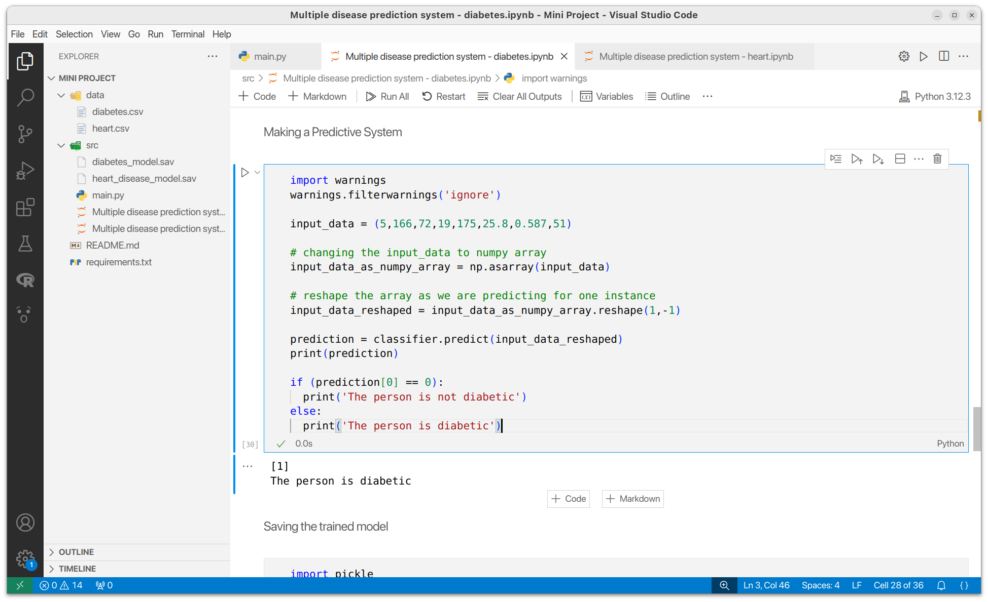
Making a Predictive System

Slide 22
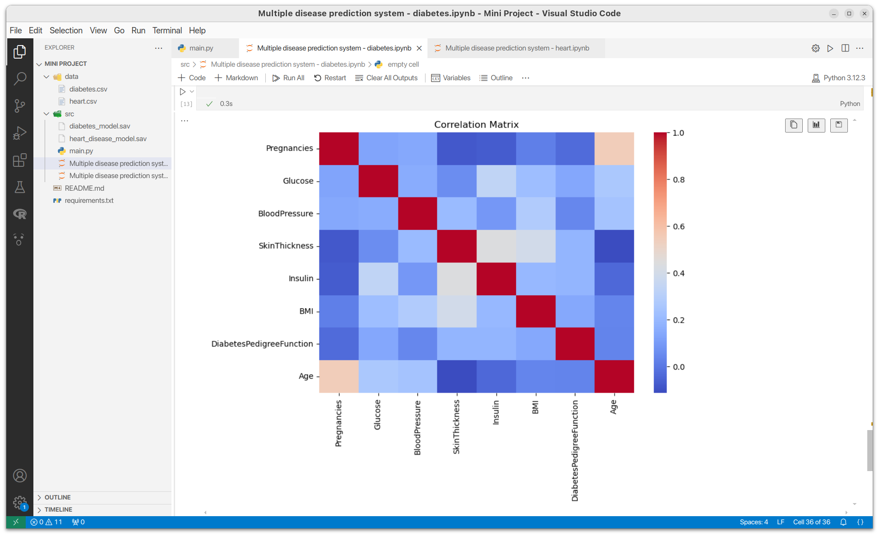
Co-relation Matrix
Notes:
remove

Slide 23
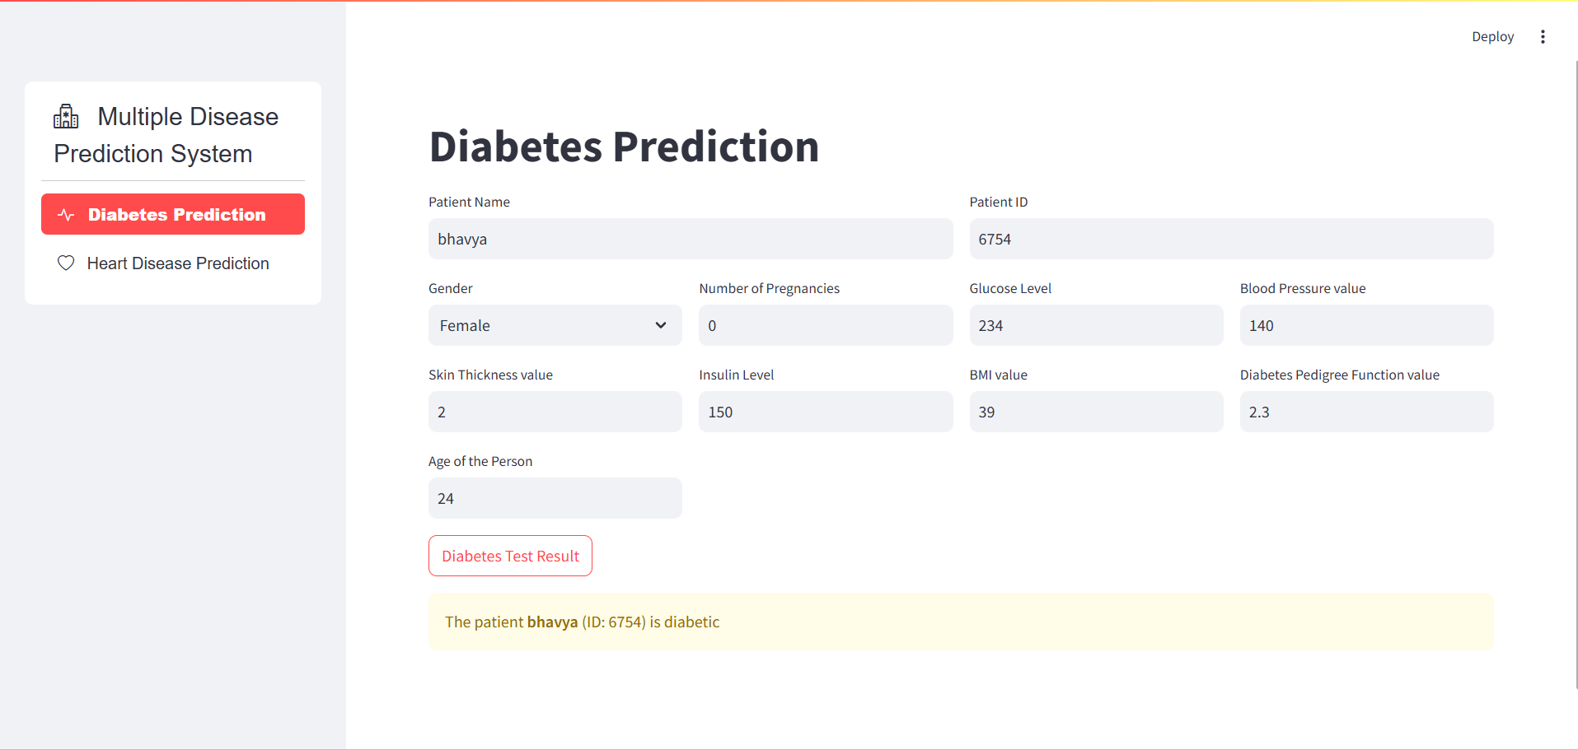
Output

Slide 24
Conclusion
Using Random Forest and Logistic Regression, we improved prediction accuracy for diabetes and heart disease over the previous Support Vector Machine (SVM) model. These models offer a balanced approach, providing both robustness and interpretability.
The improved accuracy makes the model better suited for real- world healthcare, supporting early diagnosis and treatment.

Slide 25
References
R. Katarya and P. Srinivas, “Predicting heart disease at early stages using machine learning: A survey,” in 2020 International Conference on Electronics and Sustainable Communication Systems (ICESC), 2020,pp. 302–305
Parashar A, Gupta A, Gupta A. Machine learning techniques for diabetes prediction. Int J Emerg Technol Adv Eng. 2014;4(3):672-675.

Slide 26
Thank You

